Slide 1
EENG 284 Lab 4
Hi Lo Guessing Game
Notes:
Usually the <title of the lab> is what will be called the “System” through the rest of this document

Slide 2
Lab Objectives
Verilog
Generics
LFSR
Using basic building blocks
3:8 decoder
2:1 mux
Compare
Mux
Hex2Seven
Simulation
Use of Do files
Synthesis

Slide 3
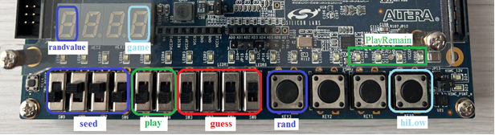
Game Play
Notes:
Replace <System> with the name of the

Slide 4
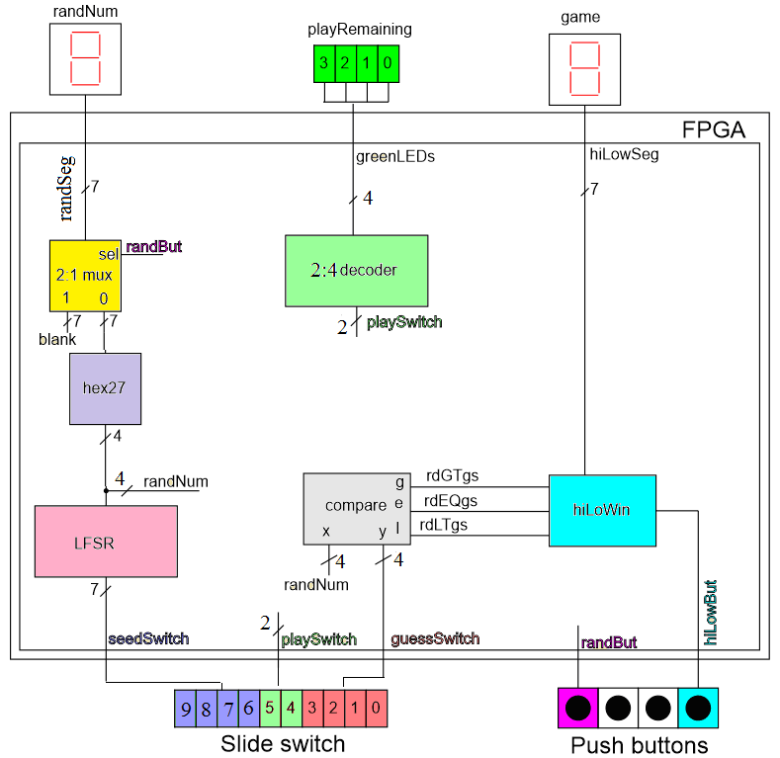
System architecture
Design
Linear Feedback Shift Register
hiLoWin
Instantiate
2:1 mux (provided)
Compare (provided)
2:4 decoder
Hex27 (use lab 2 code)
Notes:
Talk about the input is transformed into the output using the system architecture

Slide 5
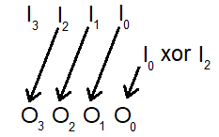
LFSR
Input
4-bit vector seed
Output
4-bit random
Implement
Use 4 assignment statements
Shift using bit indices
Use xor function ^

Slide 6
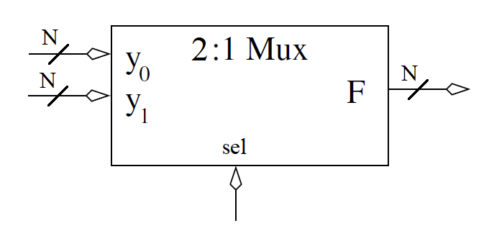
2:1 MUX
Input
2 N-bit vectors
1 bit select
Output
N-bit vector selected
Behavior
Switches the selected input to the output
Provided Code
// Module definition for the 2:1 mux
module genericMux2x1(y1, y0, sel, f);
// Module instantation for a 2:1 mux in the hiLow digital circuit
genericMux2x1 #(4) muxLsbHex(4'b1111, lsbRandHex, randBut, randLsbSeg);

Slide 7
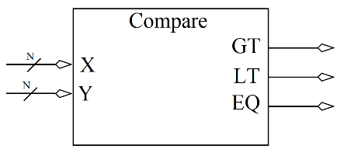
Comparator
Input
2 N-bit vectors
Output
GT = 1 when X > Y
LT = 1 when X < Y
EQ = 1 when X == Y
Behavior
Switches the selected input to the output
Provided Code

Slide 8
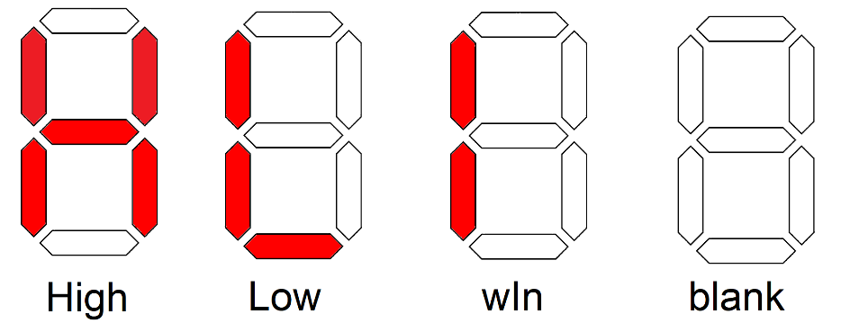
hiLow Win
Input
3-bit ones hot
Output
7-bit segments showing state of play
Implement
Consider always case statement

Slide 9
hiLow Module
Glue together
Module instantiations
Always/case statements for
2:4 decoder
hiLoWin
Reg types for always/case statement
Wire for output from instantiations

Slide 10
Provided Code
Generics
Generics allow you to specify the width of input signal
2:1 Mux
Comparator
Testbench
hiLow
// Module definition for the 2:1 mux
module genericMux2x1(y1, y0, sel, f);
// Module instantation for a 2:1 mux in the hiLow digital circuit
genericMux2x1 #(7) muxLsbHex(7'b1111111, lsbRandHex, randBut, randLsbSeg);

Slide 11
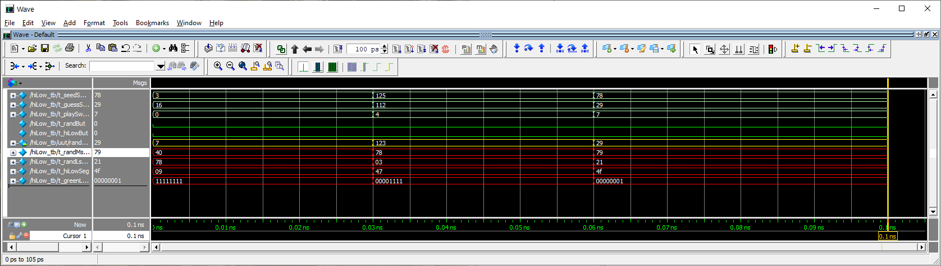
Deliverables
LFSR code and testbench for LFSR
Pin assignment
hiLow Testbench output
Working hiLow implementation on Cyclone V GX boards

